Slide 1
Chapter III
Heuristic Search Techniques

Slide 2
Contents
Generate-and-Test
Hill Climbing
  Simple Hill Climbing
  Steepest Ascent Hill Climbing
  Simulated Annealing
Best-First Search
  OR-Graph
  A* Algorithm
Problem Reduction
  AND-OR Graphs
  AO* Algorithm
Constraint Satisfaction
Means-End Analysis

Slide 3
Introduction
Different types of search strategies
  Blind Search Strategies.
    DFS
    BFS
    Iterative Deepening
  systematically explore the state space and find the goal
  lack problem-specific knowledge
  Are prohibitively inefficient in many cases.
Using problem-specific knowledge can dramatically improve the search speed.

Slide 4
Informed Search
Uses problem specific knowledge.
Based on concept of a heuristic function.

Slide 5
Heuristic
Heuristic means “rule of thumb”.
According to Judea Pearl,
  “Heuristics are criteria, methods or principles for deciding which among several alternative courses of action promises to be the most effective in order to achieve some goal”.
In heuristic search or informed search, heuristics are used to identify the most promising search path.

Slide 6
Heuristic Function
A heuristic function at a node n is an estimate of the optimum cost from the current node to a goal. It is denoted by h(n).
h(n) = estimated cost of the cheapest path from node n to a goal node
Example 1: We want a path from Kolkata to Guwahati
Heuristic for Guwahati may be straight-line distance between Kolkata and Guwahati
h(Kolkata) = euclideanDistance(Kolkata, Guwahati)

Slide 7
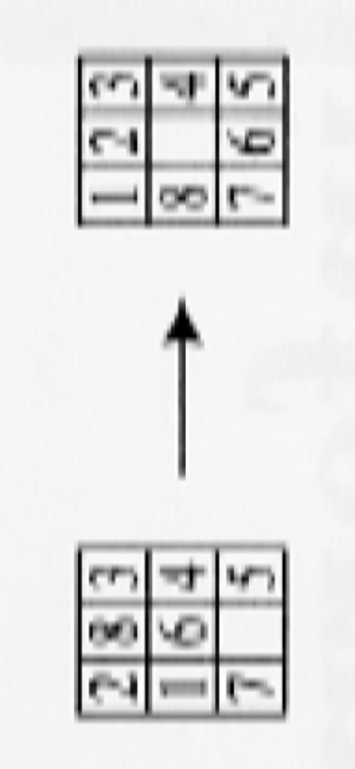
Example of heuristic function – 8 puzzle
Manhattan Distance Heuristic: sums the distance that the tiles are out of place.
Current state n
Goal state
h(n) = 1 + 1 + 0 + 0 + 0 + 1 + 0 + 2 = 5

Slide 8
Example of heuristic function – 8 puzzle
Misplaced Tiles Heuristics is the number of tiles out of place.
Current state n
Goal state
H(n)=4

Slide 9
Generate and Test (1)
Simplest of all approaches
Algorithm:
  Generate a possible solution.
  Test to see if this is actually a solution by comparing the chosen point or the endpoint of the chosen path to the set of acceptable goal states.
  If a solution has been found, quit, Otherwise return to step 1.

Slide 10
Generate-and-Test (2)
It is a depth first search procedure since complete solutions must be generated before they can be tested.
In its most systematic form, it is simply an exhaustive search of the problem space.
Can operate by generating solutions randomly but cannot guarantee a solution.
Another method, proceed systematically but ignore some paths as they are unlikely to leas to a solution.
Can be implemented as a depth first search with backtracking using a graph instead of a tree.

Slide 11
Generate and Test (3)
AI program DENDRAL infers structure of organic compounds using mass spectrogram and nuclear magnetic resonance data.
Uses a strategy called plan-generate-test.
Planning process creates lists of recommended and contraindicated substructures.
Procedure uses these lists to explore only limited set of structures.

Slide 12
Hill Climbing
Is a variant of generate-and test in which feedback from the test procedure is used to help the generator decide which direction to move in search space.
The test function is augmented with a heuristic function that provides an estimate of how close a given state is to the goal state.
Computation of heuristic function can be done with negligible amount of computation.
Hill climbing is often used when a good heuristic function is available for evaluating states but when no other useful knowledge is available.

Slide 13
Simple Hill Climbing - Algorithm
Evaluate the initial state. If it is also goal state, then return it and quit. Otherwise continue with the initial state as the current state.
Loop until a solution is found or until there are no new operators left to be applied in the current state:
  Select an operator that has not yet been applied to the current state and apply it to produce a new state
  Evaluate the new state
    If it is the goal state, then return it and quit.
    If it is not a goal state but it is better than the current state, then make it the current state.
    If it is not better than the current state, then continue in the loop.

Slide 14
Simple Hill Climbing
The key difference between Simple Hill climbing and Generate-and-test is the use of evaluation function as a way to inject task specific knowledge into the control process.
Is on state better than another ? For this algorithm to work, precise definition of better must be provided.

Slide 15
Simple Hill Climbing Example
A(20)
B(40)
C(18)
D(14)
E(22)
F(26)
G(10)
H(12)
I(13)
J(14)
K(20)
L(17)
M(20)
N(9)
O(11)
P(6)
Q(10)
R(12)
S(18)
T(15)
U(0)

Slide 16
Simple Hill Climbing Example
A(20)
B(40)
C(18)
D(14)
E(22)
F(26)
G(10)
H(12)
I(13)
J(14)
K(20)
L(17)
M(20)
N(9)
O(11)
P(6)
Q(10)
R(12)
S(18)
T(15)
U(0)

Slide 17
Simple Hill Climbing Example
A(20)
B(40)
C(18)
D(14)
E(22)
F(26)
G(10)
H(12)
I(13)
J(14)
K(20)
L(17)
M(20)
N(9)
O(11)
P(6)
Q(10)
R(12)
S(18)
T(15)
U(0)

Slide 18
Simple Hill Climbing Example
A(20)
B(40)
C(18)
D(14)
E(22)
F(26)
G(10)
H(12)
I(13)
J(14)
K(20)
L(17)
M(20)
N(9)
O(11)
P(6)
Q(10)
R(12)
S(18)
T(15)
U(0)

Slide 19
Simple Hill Climbing Example
A(20)
B(40)
C(18)
D(14)
E(22)
F(26)
G(10)
H(12)
I(13)
J(14)
K(20)
L(17)
M(20)
N(9)
O(11)
P(6)
Q(10)
R(12)
S(18)
T(15)
U(0)

Slide 20
Steepest Ascent Hill Climbing aka Gradient Search
Simple hill climbing examines actions in a fixed order and selects the first action that improves the current state.
In Steepest Ascent Hill Climbing, all successors of a node are evaluated and the one which gives the best improvement is selected.

Slide 21
Algorithm
Evaluate the initial state.
If the initial-state is a goal state then
return the initial-state and quit
else
current-state = initial-state
While a solution has not been found and a new current state was generated on the last iteration
SUCC = “bad” state
For each operator that applies to the current state do
Apply the operator and generate a new state
Evaluate the new-state
if the new -state is a goal-state then return it and quit
If the new-state is better than SUCC
SUCC = new-state
If SUCC is better than current-state then
current-state = SUCC

Slide 22
Simple Hill Climbing Example
A(20)
B(40)
C(18)
D(14)
E(22)
F(26)
G(10)
H(12)
I(13)
J(14)
K(20)
L(17)
M(20)
N(9)
O(11)
P(6)
Q(10)
R(12)
S(18)
T(15)
U(0)

Slide 23
Steepest Ascent Hill Climbing Example
A(20)
B(40)
C(18)
D(14)
E(22)
F(26)
G(10)
H(12)
I(13)
J(14)
K(20)
L(17)
M(20)
N(9)
O(11)
P(6)
Q(10)
R(12)
S(18)
T(15)
U(0)

Slide 24
Steepest Ascent Hill Climbing Example
A(20)
B(40)
C(18)
D(14)
E(22)
F(26)
G(10)
H(12)
I(13)
J(14)
K(20)
L(17)
M(20)
N(9)
O(11)
P(6)
Q(10)
R(12)
S(18)
T(15)
U(0)

Slide 25
Steepest Ascent Hill Climbing Example
A(20)
B(40)
C(18)
D(14)
E(22)
F(26)
G(10)
H(12)
I(13)
J(14)
K(20)
L(17)
M(20)
N(9)
O(11)
P(6)
Q(10)
R(12)
S(18)
T(15)
U(0)

Slide 26
Steepest Ascent Hill Climbing Example
A(20)
B(40)
C(18)
D(14)
E(22)
F(26)
G(10)
H(12)
I(13)
J(14)
K(20)
L(17)
M(20)
N(9)
O(11)
P(6)
Q(10)
R(12)
S(18)
T(15)
U(0)

Slide 27
Steepest Ascent Hill Climbing Example
A(20)
B(40)
C(18)
D(14)
E(22)
F(26)
G(10)
H(12)
I(13)
J(14)
K(20)
L(17)
M(20)
N(9)
O(11)
P(6)
Q(10)
R(12)
S(18)
T(15)
U(0)

Slide 28
Problems for Hill Climbing
Local maxima (also called foothill problem)
  all operators result in states that are worse than the current state
Plateau
  All operators produce states which have same value.
Ridges
  there is a direction in which we would like to move but none of the allowed operators takes us in that direction.

Slide 29

Problems with Hill Climbing

Slide 30
Ridges
Search area higher than surrounding areas and has a slope.
Orientation of the high region makes it impossible to traverse the ridge by single moves.

Slide 31
Methods to deal with these problems
Backtrack to some earlier node and try moving in another direction.
  Maintain list of paths almost taken and go back to one of them.
  Useful for dealing with local maxima.
Make big jump to a new section of search space
  Apply rules several times in the same direction i.e sideways move.
  Useful for plateau.
Apply two or more rules before test.
  Moving in several directions at once.
  Useful for ridges.

Slide 32
Random Restart Hill Climbing
Conducts a series of hill climbing searches from randomly generated initial states, stopping when a goal in found.
Complete with probability approaching 1 as it will eventually produce a goal state as initial state.

Slide 33
Simulated Annealing
Hill climbing with no downhill moves = incomplete
Random walk = inefficient
Hill climbing + random walk = complete + efficient = Simulated Annealing

Slide 34
Simulated Annealing
Annealing is the process of hardening metal by heating them to high temperature and then cooling gradually.
Idea: escape local maxima by allowing some "bad" moves but gradually decrease their frequency

Slide 35
Idea of the Algorithm
From current state, pick a random successor state;
If it has better value than current state, then “accept the transition,” that is, use successor state as current state;
Otherwise, do not give up, but instead flip a coin and accept the transition with a given probability (that is lower as the successor is worse).
So we accept to sometimes “un-optimize” the value function a little with a non-zero probability.

Slide 36
Simulated Annealing Approach
The systems is “heated up” and gradually cooled.
Steps
  when system is hot, take steps in both negative and positive directions
  as system cools, probability of taking a step in the negative direction is reduced
  when the system is completely cooled (probability of a step in the negative direction is 0) can identify a “general maxima”

Slide 37
Temperature Control
The rate of cooling is called the “annealing schedule”.
Can be a constant step reduction in T.
Or can be a more complex function.

Slide 38
Algorithm
set current to start state
for time = 1 to infinity
{
set Temperature to annealing_schedule[time]
if Temperature = 0
{
return current
}
randomly pick a next state from successors of current
set ΔE to value(next) - value(current)
if ΔE > 0 {
set current to next
}
else
{
set current to next with probability eΔE/Temperature
}
}

Slide 39
Implementation
Select an annealing schedule with three components
  Initial value to be used for temperature
  Criteria that will be used to decide when the temperature of the system should be reduced.
  Amount by which the temperature will be reduced each time it changes.

Slide 40
Best First Search
Depth First Search
  Not all competing branches need to be expanded.
Breadth First Search
  Does not get trapped in dead ends.
Best First Search
  Follow a single path at a time
  If more promising path available, then switch paths.

Slide 41
Algorithm
Let fringe be a priority queue containing the initial state
Loop
  if fringe is empty return failure
  Node = remove-first (fringe)
  if Node is a goal then return the path from initial state to Node
  else generate all successors of Node, and put the newly generated nodes into fringe according to their f values
End Loop

Slide 42
A(10)
Fringe : A(10)
A(10)
Fringe : D(1) B(3) C(5)
B(3)
C(5)
D(1)
Fringe : B(3) E(4) C(5) F(6)
A(10)
B(3)
C(5)
D(1)
E(4)
F(6)

Slide 43
A(10)
A(10)
B(3)
C(5)
D(1)
B(3)
C(5)
D(1)
E(4)
F(6)
G(6)
H(5)
E(4)
F(6)
G(6)
H(5)
Fringe : E(4) C(5) H(5) F(6) G(6)
I(2)
J(1)
Fringe : J(1) I(2) C(5) H(5) F(6) G(6)

Slide 44
Best-First Search: Routing problem
State | H(n)
A | 366
B | 374
C | 329
D | 244
E | 253
F | 178
G | 193
H | 98
I | 0
B
75
A
140
99
F
211
E
118
I
80
C
G
101
97
H
111
D

Slide 45
Best-First Search: Routing problem
A
B
C
E
374
329
253
State | H(n)
A | 366
B | 374
C | 329
D | 244
E | 253
F | 178
G | 193
H | 98
I | 0
B
75
A
140
99
F
211
E
118
I
80
C
G
101
97
H
111
D

Slide 46
A
B
C
E
F
G
A
178
193
366

Slide 47
A
B
C
E
F
G
A
E
I
253
0
Solution Path
A
E
F
I

Slide 48
Is it Optimal ?
No
  Cost(A — E — F — I )= 431
  Cost(A — E — G — H — I) = 418

Slide 49
Is it Complete ?
6
Start node
A
8
5
B
C
Target node
D
0

Slide 50
Difference with Hill climbing
In hill climbing, one move is selected and all the others are rejected, never to be reconsidered. This produces the straight line behavior that is characteristic of hill climbing.
In BFS, one move is selected, but the others are kept around so that they can be revisited later if the selected path becomes less promising. Further, the best available state is selected in the BFS, even if that state has a value that is lower than the value of the state that was just explored. This contrasts with hill climbing, which will stop if there are no successor states with better values than the current state.

Slide 51
OR-Graph
Search graph better than search tree to avoid duplicate paths.
Each node in the graph will contain:
  Description of problem state it represents
  Indication of how promising it is
  Parent link that points back to the best node from which it came
  List of nodes that were generated from it
Parent link will make it possible to recover the path to the goal once the goal is found.
The list of successors will make it possible, if a better path is found to an already existing node, to propagate the improvement down to its successors.
This is called OR-graph, since each of its branches represents an alternative problem solving path

Slide 52
Implementation of OR graphs
We need two lists of nodes:
  OPEN – nodes that have been generated and have had the heuristic function applied to them but which have not yet been examined. OPEN is actually a priority queue in which the elements with the highest priority are those with the most promising value of the heuristic function.
  CLOSED- nodes that have already been examined. We need to keep these nodes in memory if we want to search a graph rather than a tree, since whenever a new node is generated, we need to check whether it has been generated before.

Slide 53
A* Algorithm
Algorithm presented by Hart, Nilsson and Rafael
Variation of best first search
  f(n) = g(n) + h(n)
    g(n) = sum of edge costs from start to n
    h(n) = estimate of lowest cost path from n to goal
  f(n)=cost so far+estimated remaining cost

Slide 54
OPEN=<S,nil>
CLOSED=nil
while OPEN is not empty
  BESTNODE=minimumf(OPEN)
  Remove BESTNODE from OPEN and place in CLOSED
  if BESTNODE is a goal node,
    return success
  Else
  For each SUCCESSOR of BESTNODE do
    g(SUCCESSOR)=g(BESTNODE)+cost of getting from BESTNODE to SUCCESSOR
    If SUCCESSOR is in OPEN
    call it OLD in OPEN
    if g(OLD)>g(SUCCESSOR) then
    set parent of OLD to BESTNODE
    update f value of OLD
    discard SUCCESSOR
    else if SUCCESSOR is on CLOSED
    call it OLD in CLOSED
    if g(OLD)>g(SUCCESSOR) then
    set parent of OLD to BESTNODE
    update f value of OLD
    update f value for nodes in OPEN which has OLD as parent
    discard SUCCESSOR
    else if SUCCESSOR is not on OPEN or CLOSED then
put SUCCESSOR in OPEN
compute f(SUCCESSOR)

Slide 55
A* Search: Routing problem
State | H(n)
A | 366
B | 374
C | 329
D | 244
E | 253
F | 178
G | 193
H | 98
I | 0
B
75
A
140
99
F
211
E
118
I
80
C
G
101
97
H
111
D

Slide 56
A* Illustrated
15
H
Goal
9
0
G
12
70
12
7
30
E
D
F
6
5
13
10
12
B
9
10
15
C
8
10
A
Start

Slide 57
Observations
Role of g function
  Choice of node to expand depends on
    how good the node is i.e h
    How good the path to the node is i.e g
  If g=0 then A* will lead to any solution.
  If cost=constant, solution with fewest no. of steps will be reached.
Thus, A* can be used to find a minimal-cost path or simply any path as quickly as possible.

Slide 58
Observations
If h is a perfect estimator of the distance of the node to the goal, then A*immediately converges to the goal without any search.
If h is 0 ,the search will be controlled by g.
  If g=0 then search strategy is random.
  If g=1 then search is Breadth First.
  All nodes at one level will have lower values of g than the nodes in the next level.

Slide 59
h*(n) underestimates h(n)
Cost of all arcs is 1.
Problem : underestimating h(B)
A
B
C
(4+1)
D
(5+1)
(3+1)
E
(3+2)
F
(3+3)

Slide 60
h*(n) overestimates h(n)
Suppose there is a direct path from D to G, we will never find it.
Problem : overestimating h(D)
A
B
C
(4+1)
D
(5+1)
(3+1)
E
(2+2)
F
(1+3)
G
(0+4)

Slide 61
Admissible Heuristics
A heuristic h(n) is admissible if for every node n,h(n) ≤ h*(n), where h*(n) is the true cost to reach the goal state from n.
An admissible heuristic never overestimates the cost to reach the goal, i.e., it is optimistic

Slide 62
Admissibility of A*
A* is admissible subject to the following conditions
  Every node has a finite no. of successors.
  Every arc in the graph has a cost greater than some ε> 0
  Heuristic function: for every node n, h(n) ≤ h*(n)

Slide 63

Optimality of A* (proof)
Suppose some suboptimal goal G₂ has been generated and is in the fringe. Let n be an unexpanded node in the fringe such that n is on a shortest path to an optimal goal G.

Slide 64
Optimality of A* (proof)
f(G₂) = g(G₂) since h(G₂) = 0
g(G₂) > g(G) since G₂ is suboptimal
f(G) = g(G) since h(G) = 0
f(G₂) > f(G) from above
f(G₂) > f(G) from above
h(n)≤ h^*(n) since h is admissible
g(n) + h(n)≤ g(n) + h*(n)
f(n) ≤ f(G)
Hence f(G2) > f(n), and A* will never select G2 for expansion

Slide 65

Consistent heuristics
A heuristic is consistent if for every node n, every successor n' of n generated by any action a,
If h is consistent, we have
f(n') = g(n') + h(n')
= g(n) + c(n,n') + h(n')
≥ g(n) + h(n)
≥ f(n)
i.e., f(n) is non-decreasing along any path.
Theorem: If h(n) is consistent, A* is optimal
h(n) ≤ c(n,n') + h(n')

Slide 66
Consistent heuristics
If a heuristic h is inconsistent, we can tweak the f values so that they behave as if h were consistent, using the pathmax equation:
f(n') = max(f(n), g(n') + h(n'))
This ensures that the f values never decrease along a path from the start to a goal.
Given nondecreasing values of f, we can think of A* as searching outward from the start node through successive contours of nodes, where all of the nodes in a contour have the same f value.

Slide 67
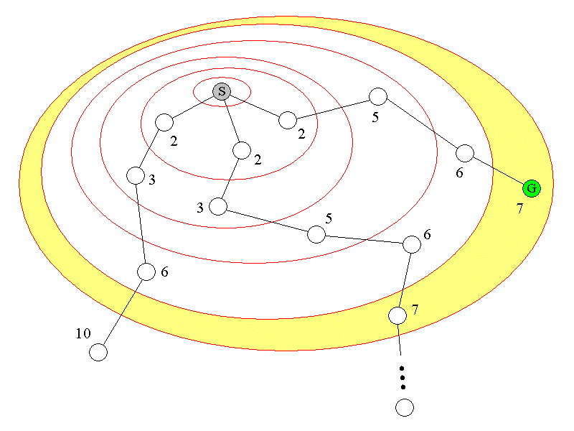
Consistent heuristics
For any contour, A* examines all of the nodes in the contour before looking at any contours further out. If a solution exists, the goal node in the closest contour to the start node will be found first.

Slide 68
Proof of Completeness of A*
Let G be an optimal goal state.
A* cannot reach a goal state only if there are infinitely many nodes where f(n) ≤ C*.
This can only happen if either happens:
  There is a node with infinite branching factor. The first condition takes care of this.
  There is a path with finite cost but infinitely many nodes. But we assumed that Every arc in the graph has a cost greater than some ε> 0. Thus if there are infinitely many nodes on a path g(n) > f*, the cost of that path will be infinite.
Lemma: A* expands nodes in increasing order of their f values.
A* is thus complete and optimal, assuming an admissible and consistent heuristic function (or using the pathmax equation to simulate consistency).
A* is also optimally efficient, meaning that it expands only the minimal number of nodes needed to ensure optimality and completeness.

Slide 69
AND-OR graphs
AND-OR graph (or tree) is useful for representing the solution of problems that can be solved by decomposing them into a set of smaller problems, all of which must then be solved.
One AND arc may point to any number of successor nodes, all of which must be solved in order for the arc to point to a solution.
Goal: Acquire TV Set
Goal: Steal a TV Set
Goal: Earn some money
Goal: Buy TV Set

Slide 70
AND-OR graph examples
A
A
9
38
B
C
D
B
C
D
5
3
4
17
9
27
E
F
G
H
I
J
5
10
3
4
15
10

Slide 71
Problem Reduction
Planning how best to solve a problem that can be recursively decomposed into sub problems in multiple ways.
Example
  Matrix multiplication
  Tower of Hanoi

Slide 72
Matrix Multiplication
Multiply n matrices
  A1 x A2 x A3 x….An
Can be evaluated as
  (((A1 x A2) x A3) x A4)….
OR
  ((A1 x A2) x (A3 x A4)) ((A5 x A6) x (A7 x A8))…

Slide 73
Matrix Multiplication
A1
A2
A3
A4
A1x A2
A3x A4
A1x A2 x A3 x A4
A1x A2 x A3
A4
A1x A2
A3
A1
A2

Slide 74
Formulation
AND/OR Graphs
  OR node represents a choice between possible decompositions.
    Have to consider minimum cost
  AND node represents a given decomposition.
    Have to consider sum of the costs
Game Tree
  Max node represents choice of my opponent
  Min node represents my choice

Slide 75
Problem
Given (G,S,T) where
  G : specified AND/OR graph
  S : start node
  T : set of terminal nodes
  h(n) : heuristic function estimating the cost of solving the sub problem at n
To find:
  A minimum cost solution tree

Slide 76
AO* Algorithm
Initialize
  G*={s}, f(s)=h(s)
  if s is in T, label s as SOLVED.
Terminate
  If s is SOLVED, then terminate
Select
  Select a non-terminal leaf node n from the marked sub tree.
Expand
  Make explicit the successor of n
  For each new successor , m
    Set f(m)=h(m)
    If m is terminal, label m SOLVED
Cost Revision
  Call cost-revise(n)
Loop
  Goto step 2

Slide 77
Cost Revision
Create Z={n}
If Z={ } return
Select a node m from Z such that m has no descendents in Z
If m is an AND node with successors r1,r2,…rk
  Set f(m)=∑[f(ri)+c(m,ri)]
  Mark the edge to each successor of m.
  If each successor is labeled SOLVED, then label m as SOLVED.
If m is a OR node with successors r1,r2,…rk
  Set f(m)=min{f(ri)+c(m,ri)}
  Mark the edge of the best successor of m
  If marked successor is labeled SOLVED, label m as SOLVED.
If the cost of m has changed, then insert those parents of m into Z from which m is a marked successor.

